Slide 1
Introduction to SQL II

Slide 2
Agenda
Review basic SQL
Learn more commands (HAVING, JOIN)
Brief discussion of SQL optimization
2
Notes:
2

Slide 3
What is SQL?
A tool for relational database management system
courses
classes
instructors
Course | Title
30000 | Financial Accounting
30001 | Cost Analysis and Internal Controls
Course | Instructor | Room
30000 | Ball | C06
30000 | Bischof | C04
30001 | Gallemore | C02
Instructor | Department
Ball, Ray | Accounting
Bischof, Jannis | Accounting
Gallemore, John | Statistics
3
Notes:
3

Slide 4
SQL Sandbox
Go to https://modeanalytics.com
or just search “Mode Analytics”
Sign in using these credentials
boothanalytics@gmail.com
PW: ilovesql
If you have any trouble, just create an account. It’s free and doesn’t ask for anything but email address

Slide 5
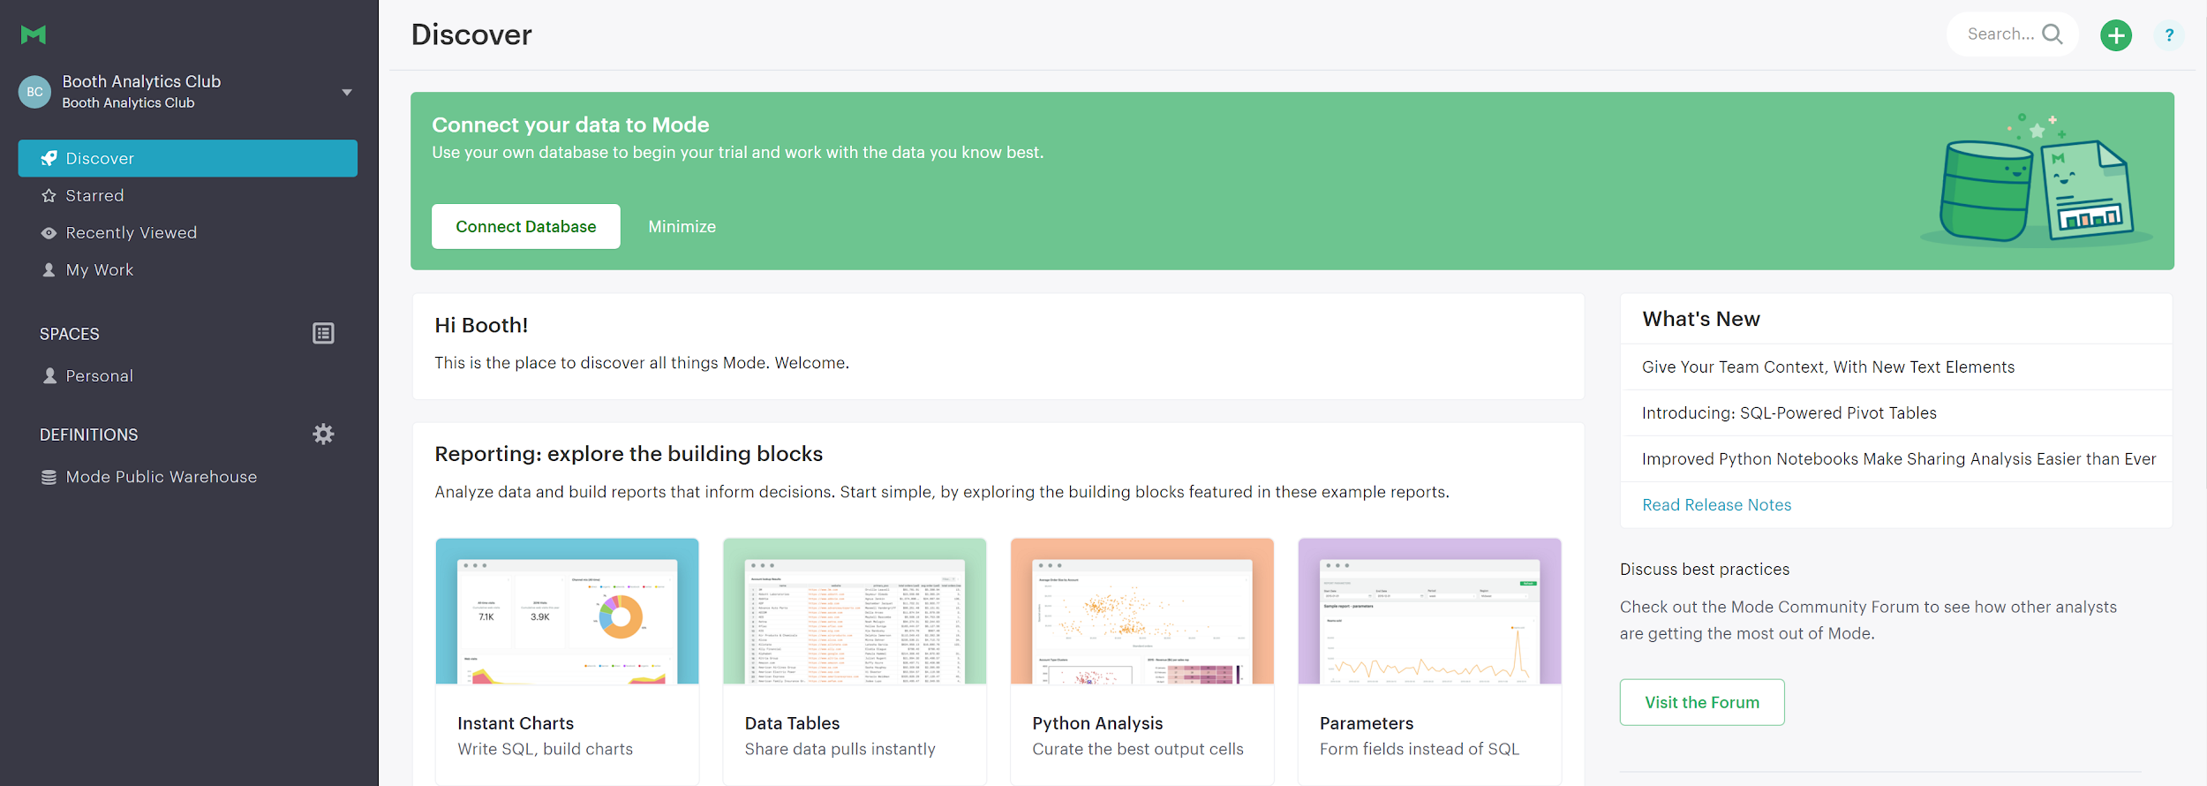
Click the Green Plus Sign

Slide 6
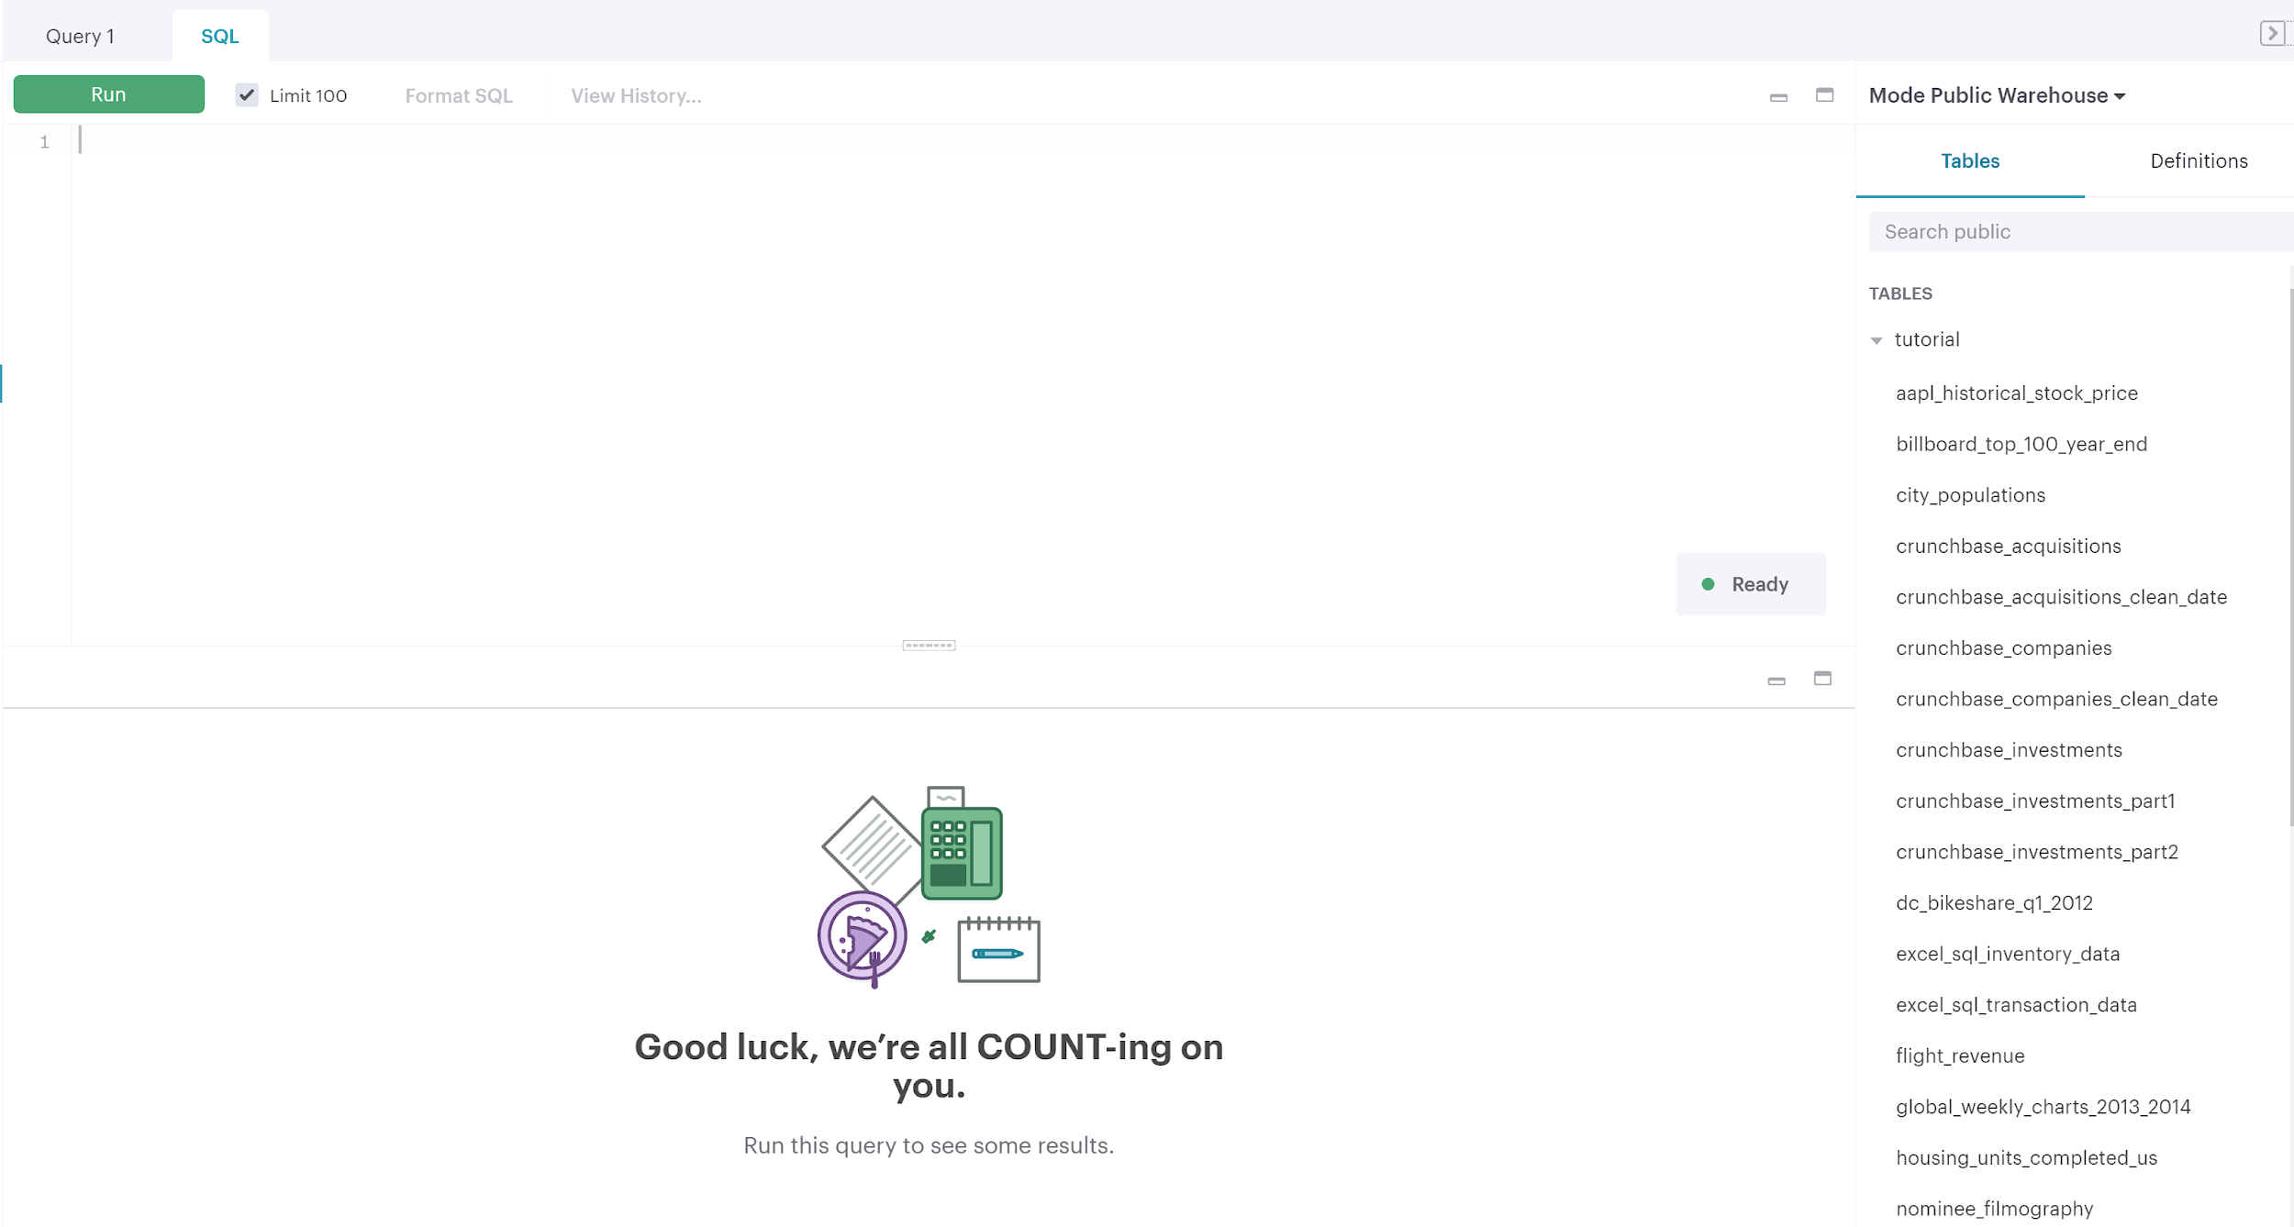
Welcome to the editor!
Query Editor
Tutorial Tables
Results

Slide 7
Quick GUI Notes
This is actually SQL Server, not MySQL
A few minor differences (aliasing works slightly different, double quotes no longer work)
This GUI is much nicer
However, you need to specify a table and a database

Slide 8
REVIEW
SELECT, WHERE, GROUP BY, ORDER BY

Slide 9
Select <fields> from <tablename> where <limits>;
Returns some subset of data from a table
SELECT nominee
FROM tutorial.oscar_nominees
WHERE year=2012;
Can use any of the operators (see cheatsheet) as well as AND and OR
Notes:
SELECT name
FROM tutorial.oscar_nominees
WHERE year=2012;

Slide 10
Order by
SELECT <fields>
FROM <tablename>
ORDER BY <field> <order>;
SELECT *
FROM tutorial.city_populations
ORDER BY population_estimate_2012 DESC;
Notes:
SELECT *
FROM tutorial.city_populations
ORDER BY population_estimate_2012 DESC;

Slide 11
Group by
Aggregate functions (see worksheet) are used to gather information about data
Commonly used functions: COUNT(), COUNT(DISTINCT), SUM(), AVG(), MAX(), MIN()
SELECT state, AVG(population_estimate_2012
FROM tutorial.city_populations
GROUP BY state;
Notes:
SELECT state, AVG(population_estimate_2012)
FROM tutorial.city_populations
GROUP BY state;

Slide 12
Try it out
In the sandbox, try more complicated SELECTs.
SELECT teacher, AVG(sat_writing)
FROM tutorial.sat_scores
GROUP BY teacher
ORDER BY AVG(sat_writing) DESC;
Which school has the highest sat_math scores?
(Bonus) Which school has the highest total sat_scores?
Notes:
SELECT school, AVG(sat_math)
FROM tutorial.sat_scores
GROUP BY school
ORDER BY AVG (sat_math) DESC;
SELECT school, AVG(sat_math+sat_writing+sat_verbal) total
FROM tutorial.sat_scores
GROUP BY school
ORDER BY total DESC;

Slide 13
MORE MODIFICATIONS
Aliasing, HAVING

Slide 14
Aliasing
Using the AS command, you can alias any column as any other name
SELECT school, COUNT(*) AS students
FROM tutorial.sat_scores
GROUP BY school;
You can use this alias in your ORDER BY statement
Notes:
SELECT school,
COUNT(*) AS students
FROM tutorial.sat_scores
GROUP BY school;

Slide 15
Select <fields> from <tablename> HAVING <limits>;
Returns some subset of data you queried from a table
SELECT origin, COUNT(*)
FROM tutorial.us_flights
GROUP BY origin
HAVING origin='ORD' OR origin = 'JFK';
The key difference is that while WHERE subsets the data in the table, HAVING subsets the data from your query.
Notes:
SELECT origin, count(*) FROM tutorial.us_flights GROUP BY origin HAVING origin='ORD' or origin = 'JFK';

Slide 16
HAVING
Must be used in conjunction with aggregate functions and GROUP BY
SELECT unique_carrier, COUNT(*)
FROM tutorial.us_flights
GROUP BY unique_carrier
HAVING COUNT(*)>10000;
The key difference is that while WHERE subsets the data in the table, HAVING subsets the data from your query.

Slide 17
Try it out
SELECT origin, AVG(arr_delay)
FROM tutorial.us_flights
GROUP BY origin
HAVING AVG(arr_delay) >20;
Which origins have more than 2000 flights?
(Bonus) Which airlines have more than 100 flights that were cancelled?
(Double Bonus) If I am flying from ORD what airlines have more than 10% of flights cancelled?
Notes:
SELECT origin, COUNT(*)
FROM tutorial.us_flights
GROUP BY origin
HAVING COUNT(*) >2000;
SELECT unique_carrier, COUNT(*)
FROM tutorial.us_flights
WHERE cancelled=1
GROUP BY unique_carrier
HAVING COUNT(*) >100;
SELECT unique_carrier, sum(cancelled)/COUNT(*)
FROM tutorial.us_flights
WHERE origin='ORD'
GROUP BY unique_carrier
HAVING sum(cancelled)/COUNT(*)>.10

Slide 18
A note on SQL Commands
There are many different SQL commands for manipulating strings, dates, or numbers – like CONCAT, LENGTH, and SUBSTRING
We have focused on aggregate functions, but there are also logical functions like IF, COALESCE, CASE-WHEN
We will not cover these functions because they tend to vary by RDMBS (MySQL vs SQL Server vs PostgreSQL)

Slide 19
COMBINING TABLES
INNER JOIN, LEFT JOIN

Slide 20
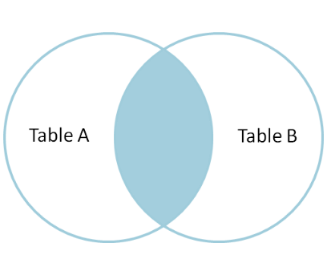
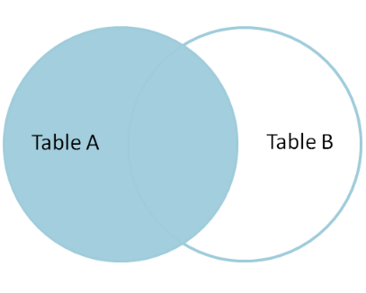
Joins
INNER JOIN:
LEFT OUTER JOIN:
for more info:
http://www.sql-join.com/sql-join-types/

Slide 21
Inner Join
Table A
Table B
SELECT *
FROM AS A
INNER JOIN AS B
ON A.order_id=B.order_id
order_id | customer
1 | Anne
2 | John
3 | Charlie
4 | Bob
order_id | widgets_sold
1 | 25
4 | 15
7 | 100
9 | 1
order_id | customer | order_id | widgets_sold
1 | Anne | 1 | 25
4 | Bob | 4 | 15

Slide 22
Inner Join
Merges two tables based on some defined matching of fields
SELECT *
FROM tutorial.oscar_nominees AS noms
INNER JOIN tutorial.nominee_filmography AS films
ON noms.nominee = films.name;
This will output only rows where the values line up
Notes:
Try and smooth this out a bit, maybe look at online training

Slide 23
Inner Join
Alternately, we can also write:
SELECT *
FROM tutorial.oscar_nominees AS noms, tutorial.nominee_filmography AS films
WHERE noms.nominee=films.name;
This will output only rows where the values line up
Notes:
Try and smooth this out a bit, maybe look at online training

Slide 24
Try it out
SELECT *
FROM tutorial.oscar_nominees AS noms
INNER JOIN tutorial.nominee_filmography AS films
ON noms.nominee=films.name;
What is the top genre of the best actor winner in 2012? (Hint: Use the tables nominee_information and oscar_nominees)
(Double Bonus) What is the birthday of the actress who has been nominated for the most oscars? What about the actor who won the most oscars?
Notes:
SELECT *
FROM tutorial.oscar_nominees noms
INNER JOIN tutorial.nominee_information info
ON noms.nominee=info.name
WHERE noms.year=2012 AND category='actor in a leading role’
SELECT noms.nominee,info.birthday,count(*)
FROM tutorial.oscar_nominees noms
INNER JOIN tutorial.nominee_information info
ON noms.nominee=info.name
GROUP BY noms.nominee,info.birthday
ORDER BY count(*) DESC
SELECT noms.nominee,info.birthday,count(*)
FROM tutorial.oscar_nominees noms
INNER JOIN tutorial.nominee_information info
ON noms.nominee=info.name
WHERE winner='true'
GROUP BY noms.nominee,info.birthday
ORDER BY count(*) DESC

Slide 25
Walk through a query
What data do we need?
Does it require a join?
Do we want to subset that data?
Do we want to roll that data up?
What information do we care about?
How do we need to edit our result?
SELECT * FROM ____
INNER JOIN _____
WHERE _____
GROUP BY ____
SELECT _____
HAVING ____,
ORDER BY ____

Slide 26
Left Join & Right Join
SELECT *
FROM A
LEFT JOIN B
ON A.order_id=B.order_id
Table A
Table B
order_id | customer
1 | Anne
2 | John
3 | Charlie
4 | Bob
order_id | widgets_sold
1 | 25
4 | 15
7 | 100
9 | 1
order_id | customer | order_id | widgets_sold
1 | Anne | 1 | 25
2 | John
3 | Charlie
4 | Bob | 4 | 15
SELECT *
FROM A
RIGHT JOIN B
ON A.order_id=B.order_id
order_id | customer | order_id | widgets_sold
1 | Anne | 1 | 25
4 | Bob | 4 | 15
7
9

Slide 27
Left Join
Merges two tables, but leaves values null when the second table in the join does not match
SELECT *
FROM tutorial.nominee_filmography AS films
LEFT JOIN tutorial.oscar_nominees AS noms
ON films.name=noms.nominee
AND films.movie_title=noms.movie
LEFT JOINs are useful when you want to gather more information but not lose your initial data set

Slide 28
Try it out
SELECT *
FROM tutorial.nominee_filmography AS films
LEFT JOIN tutorial.oscar_nominees AS noms
ON films.name=noms.nominee
AND films.movie_title=noms.movie
What movies did Meryl Streep act in where she wasn’t nominated for an Oscar?
(Bonus) What percentage of these movies were nominated for Oscars? (Feel free to use two queries)
(Extra Difficult Double Bonus) Answer the bonus question in one query
Notes:
SELECT *
FROM tutorial.nominee_filmography films
LEFT JOIN tutorial.oscar_nominees noms
ON films.name=noms.nominee
AND films.movie_title=noms.movie
WHERE category IS NULL
AND name='Meryl Streep'
SELECT count(*)
FROM tutorial.nominee_filmography films
LEFT JOIN tutorial.oscar_nominees noms
ON films.name=noms.nominee
AND films.movie_title=noms.movie
SELECT count(*)
FROM tutorial.nominee_filmography films
INNER JOIN tutorial.oscar_nominees noms
ON films.name=noms.nominee
AND films.movie_title=noms.movie
SELECT SUM(CASE WHEN noms.winner IS NULL THEN 0 ELSE 1 END),COUNT(*)
FROM tutorial.nominee_filmography films
LEFT JOIN tutorial.oscar_nominees noms
ON films.name=noms.nominee
AND films.movie_title=noms.movie

Slide 29
Putting it all together
Write the query to calculate the difference in weekly from the following table:
SELECT *
FROM tutorial.global_weekly_charts_2013_2014
WHERE game = 'Pokemon X/Y';
create a new column called weekly_change which contains this data.
Hint: Use nested SQL queries and inner join
Notes:
select *, weekly-prev_weekly as weekly_change from tutorial.global_weekly_charts_2013_2014 as curr
inner join
(select week,weekly from tutorial.global_weekly_charts_2013_2014
where game = 'Pokemon X/Y') as shifted (week, prev_weekly)
on curr.week-1=shifted.week
where curr.game = 'Pokemon X/Y'

Slide 30

Summary of SQL Joins
Notes:
select *, weekly-prev_weekly as weekly_change from tutorial.global_weekly_charts_2013_2014 as curr
inner join
(select week,weekly from tutorial.global_weekly_charts_2013_2014
where game = 'Pokemon X/Y') as shifted (week, prev_weekly)
on curr.week-1=shifted.week
where curr.game = 'Pokemon X/Y'

Slide 31
Backup

Slide 32
OPTIMIZING QUERIES
Keys, optimizing joins

Slide 33
Keys
SQL tables have various Keys or Indexes
These keys act as a way SQL sorts the data in these tables
For example, a courses table would likely be keyed on course, but might also be keyed on title
courses
Course | Title | Last Offered
30000 | Financial Accounting | SPR 2016
30001 | Cost Analysis and Internal Controls | FAL 2015
33040 | Macro | SPR 2016
33
Notes:
33

Slide 34

Keys
Think of SQL tables like a phone book, with the “key” being the last name of a person
Looking up someone by their last name is incredibly easy and fast, but to look them up by their first name would require reading every entry in the phone book
34
Notes:
34

Slide 35
Explain
Allows you to estimate the time of your query
EXPLAIN
SELECT *
FROM sb_employees
WHERE state='IN'
The explain command tells you how many rows the computer must sort through

Slide 36
Explain - Examples
EXPLAIN SELECT * FROM sb_employees WHERE state='IN'
EXPLAIN SELECT * FROM sb_employees WHERE emp_id=50
100 Rows
1 Row

Slide 37
Explain - Examples
EXPLAIN SELECT * FROM sb_employees AS a INNER JOIN sb_departments AS b ON a.emp_id=b.emp_id
EXPLAIN SELECT * FROM sb_employees AS a INNER JOIN sb_departments AS b ON a.zipcode=b.comp_dept
100 Rows
10000 Row

Slide 38
Final Thoughts
Remember how to determine what is in a table (SHOW TABLES, DESCRIBE, SELECT *)
Remember how to grab data from tables (SELECT, WHERE, INNER JOIN)
Remember how to manipulate that data (GROUP BY, COUNT, HAVING)
38
Notes:
38

Slide 39
Credits
Some of the join diagrams are courtesy of Jeff Atwood: http://blog.codinghorror.com/a-visual-explanation-of-sql-joins/
Obviously, coderzone is the source for environment, so thanks to whoever made that

